Slide 1








VORTEXA
3.0
12 HRS HACKATHON
POWERED BY A.I.R.S
DOMAIN & NO : 7,G-02,
GovFix: Configurable Public-Institution Workflow Engine
PROBLEM STATEMENT TITLE :
TEAM NAME :
OrbitX
TEAM ID :
6723788

Slide 2


PROBLEM STATEMENT
Universities handle a large number of service requests every semester, including classroom projector failures, laboratory equipment breakdowns, Wi-Fi outages, hostel maintenance issues, power faults, water-supply problems, and IT infrastructure incidents. However, existing campus ERP portals, basic online forms, and conventional ticketing systems often fail to ensure that these requests are resolved transparently, on time, and by the correct authority.
As a result, many tickets remain stuck in “In Progress” for long periods, are closed without proof of repair, miss service-level deadlines without escalation, or are modified later without a reliable audit trail. In addition, unrestricted AI-based systems can introduce risk if they are allowed to change ticket status, approve closure, assign personnel, or alter institutional records.
Therefore, there is a need for a secure and intelligent university service-request system that:
Enforces a valid, step-by-step workflow for every complaint.
Allows actions only by authorized roles such as requester, supervisor, technician, and registrar.
Automatically monitors SLA deadlines and escalates overdue requests.
Requires completion evidence and supervisory approval before final closure.
Maintains a tamper-evident audit trail of all accepted, rejected, and escalated actions.
Uses AI only as a read-only advisory assistant, without allowing it to make or modify institutional decisions.

Slide 3


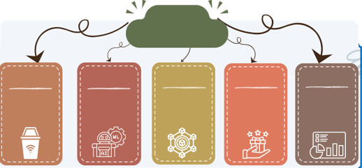
IDEA TITLE / PROPOSED SOLUTION
Proposed Solution / Approach
PROTOTYPE IMPLIMENTATION
GovFix is a secure, backend-enforced campus service-request workflow engine designed for universities. It replaces ordinary ticketing systems with a controlled process in which every request follows defined rules, deadlines, role permissions, evidence requirements, and audit records.
“Deterministic rules govern authority, state transitions, and deadlines; AI informs but never overrides.
GovFix manages maintenance, IT, infrastructure, and equipment-related complaints raised by students, faculty, or staff. Instead of allowing users or technicians to freely change ticket status, the system uses a rule-based workflow that permits only valid actions by authorized roles.
For example, a student can report “Projector not working in Room 304,” but cannot assign a technician or close the ticket. A technician can inspect and repair the projector, upload proof, and propose closure—but only a supervisor can approve the final closure.
SCAN FOR PROTOTYPE
Click here for Prototype :
https://unisol.mooo.com/
100% OF THEPROTOTYPE IS
ALREADY COMPLETED!!!
Innovation
and Uniqueness
valid workflow path :
Authorized decision making
Deadline
accountability:
Proof before closure :
Verifiable history
Change ticket status.
Assign an officer or technician.
Change SLA deadlines.
Approve a
closure.
Modify audit records or the database.

Slide 4
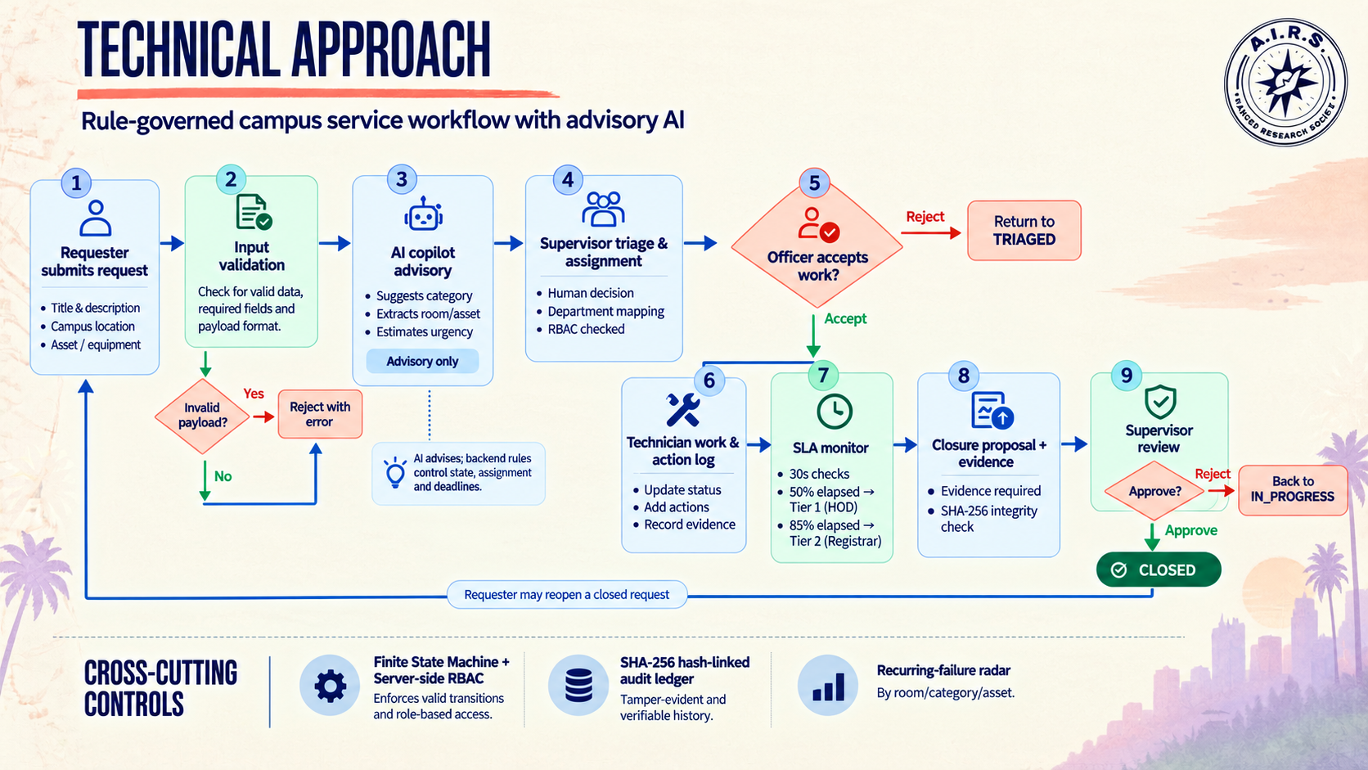






TECHNICAL APPROACH
Components / Technology stack to be used

Slide 5


FEASIBILITY AND VIABILITY
Potential Challenges & Risks
Overcoming Challenges
Analysis of Feasibility of our Idea
Deterministic Workflow Engine: Validates state transitions and role-based permissions.
Tamper-Evident Audit Ledger: SHA-256 hash chaining supports audit integrity and tamper detection.
AI-Powered Triage: Assists with request categorization, urgency assessment, and notification drafting.
SLA Management: Supports deadline tracking and tier-based escalation.
Evidence-Based Closure: Supports verification before requests are marked resolved.
Scalable Design Potential: The modular workflow, SLA, audit, and AI services can be extended as institutional requirements grow.
To prevent tickets from staying unresolved, GovFix assigns SLA deadlines and automatically escalates overdue cases to supervisors and registrars.
To prevent false ticket closure, the technician must provide repair notes and completion evidence before proposing closure.
To ensure accountability, a supervisor must review and approve the closure proposal before the ticket can become closed.
To stop unauthorized users from performing restricted actions, GovFix applies backend-enforced role-based access control.
To prevent invalid status changes, the finite-state machine rejects illegal ticket transitions with an explicit HTTP 409 error.
To handle external AI service failure, GovFix uses offline keyword and regex-based heuristics as a fallback.
GovFix is technically feasible because it uses standard technologies such as Node.js, Express, REST APIs, role-based access control, scheduled background services, and SHA-256 hashing.
The project is economically feasible for an MVP because it is designed to run locally and does not require compulsory paid AI APIs.
The system is operationally feasible because it follows existing university roles: students/faculty raise requests, supervisors assign work, technicians repair issues, and registrars monitor escalations.
The deterministic finite-state machine makes the workflow practical because every ticket follows a fixed and controlled lifecycle from submission to closure or reopening.

Slide 6

IMPACT AND BENEFITS
POTENTIAL IMPACTS
BENEFITS
Target User :
SOCIAL
Institutional Accountability :
Establishes clearer ownership of service requests, promotes responsible handling, and improves transparency across departments.
Proactive Maintenance:
Identifies recurring infrastructure issues in classrooms, laboratories, and campus facilities, helping institutions recognize patterns before problems repeatedly disrupt daily activities.
Data-Driven Governance:
Uses request histories, resolution trends, and escalation records to help administrators identify bottlenecks, prioritize resources, and make informed maintenance decisions.
Scalable Digital Governance:
Provides a workflow model that can potentially extend beyond maintenance to IT support, hostel facilities, administrative services, and other institutional departments.
GovFix supports better institutional governance by giving administrators
visibility into Tier-1 and Tier-2 escalations, delayed cases, and service-performance patterns.
GovFix improves transparency because students, faculty, and staff can view
The status of their own service requests and live SLA information.
ECONOMIC
GovFix can reduce the time spent by students, faculty, and staff on repeated
follow-up calls, physical visits, informal messages, and manual status checking.
GovFix can reduce dependence on expensive proprietary ticketing or cloud
ITSM subscriptions because the proposed MVP is designed for local deployment and does not require paid AI APIs.
ENVIRONMENTAL
GovFix can reduce paper usage by replacing physical complaint registers,
printed maintenance forms, manual approval slips, and paper-based service logs with digital tickets and audit records.
GovFix can reduce repeated technician visits by requiring structured fault
descriptions, diagnostic notes, and completion evidence.

Slide 7
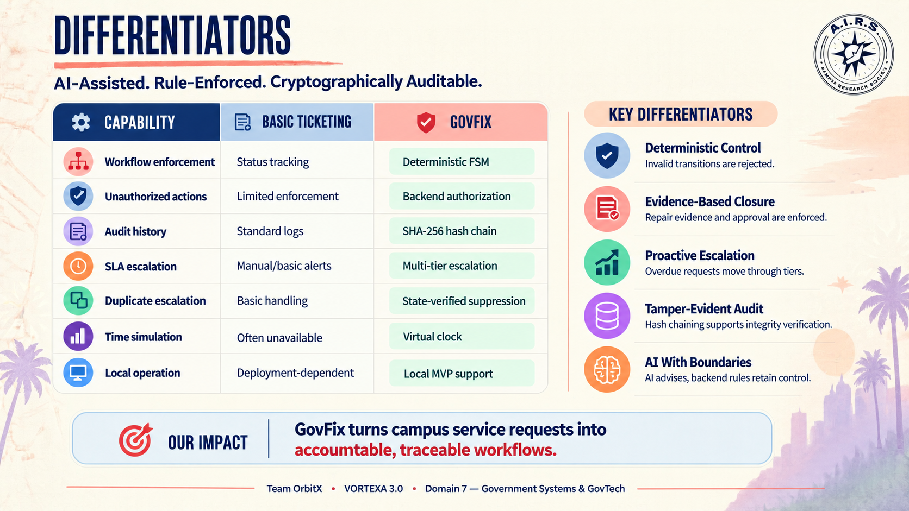
DIFFERENTIATOR

Slide 8










THANK YOU!
Game’s
Still On
VORTEXA 3.0
AIRS

